Slide 1
Country Partnership Framework for The Republic of Mozambique FY2016-FY2020 Succeeding the Country Partnership Strategy FY2012-FY2015

Slide 2
Foundations of the Country Partnership Framework (CPF)
Programa Quinquenal do Governo 2015-2019
Systematic Country Diagnostic (SCD)
Lessons learned from implementation of Country Partnership Strategy (CPS FY12-15)
World Bank Country Survey 2014
Consultations with Government, national and local stakeholders, and Donor Partners

Slide 3
Looking ahead
main observations from Systematic Country Diagnostic
Need to prepare for an increasingly young population Mozambique is experiencing a demographic transition, with high fertility rates and declining infant mortality levels contributing to a growing population of young people. In the absence of structural changes to the economy, it will be challenging to find productive employment for new workers entering the labor market, and social services are likely to become increasingly strained.
Develop a new growth model linking extractives with non-resource private sector As extractive industries are expected to play an increasingly important role in the economy, Mozambique’s future growth model should strive to tighten linkages with the non-resource private sector. The development of growth corridors can help to boost diversification and private investment. Furthermore, efforts to improve infrastructure and develop value chains in the agricultural sector could increase the productivity of smallholder farmers and provide a more inclusive vehicle for growth.
Inclusive growth as a vehicle for social cohesion Strengthening productivity of the agricultural sector and addressing challenges of household enterprises such as lack of infrastructure and access to finance are critical for promoting inclusive growth. As the urban population is growing in pursuit of better services and jobs, Mozambique’s future growth model should harness rural-urban linkages. Cities can connect farmers to markets, provide a hub for the transportation of goods, and harness global connections.

Slide 4
Important note on poverty trends (based on 2009 data)
The pace of poverty reduction is declining
The distribution of poverty reduction is uneven with large geographical inequalities
Poverty reduction is less responsive to economic growth than it is in other countries
High inequality weakens the relationship between growth and poverty reduction
The most exposed group is people living in single female-headed households. When female-head is separated or divorced headcount poverty reaches 59%

Slide 5
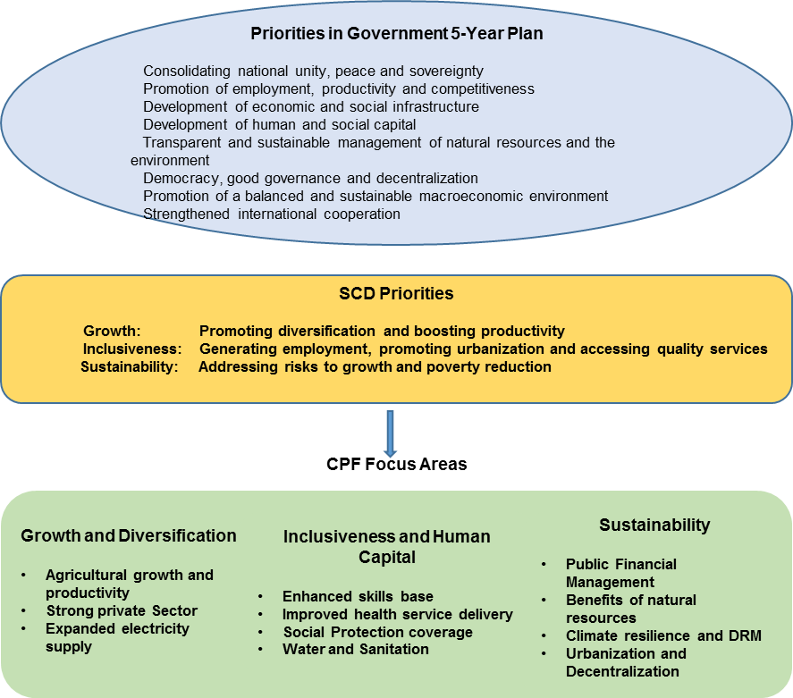
Mapping the PQG , the SCD priorities, and the CPF focus areas

Slide 6
From CPS to CPF – enhancing focus
CPs
CPF
17 Objectives
30 Indicators
4 DPO series
Few multisector projects
5-6% of lending in Agriculture
Education with focus on quantity
Transport sector with large infrastructure investments
11 Objectives
20 Indicators
2 thematic DPO series
More projects with multisector approach
15% of lending in Agriculture
Education with focus on quality
Transport sector with more rural infrastructure

Slide 7
CPF Objectives and Indicators
Focus Area 1, Promoting Diversified Growth and Enhanced Productivity
Increase agriculture growth including productivity and market participation Percentage of smallholder farmers marketing part of their production Percentage of production marketed Number of households and investors covered by formal land user rights Number of farmers connected by agribusiness investments
2. Strengthen local private sector and improve access to finance Number of jobs supported/generated Number of MSME loans supported by private sector clients
3. Expand access to reliable and efficient electricity supply Average interruption frequency per year Rate of electricity losses

Slide 8
Focus Area 2, Inclusiveness and Human Capital
4. Enhancing the skills base Primary completion rate Research institutions/organizations or companies partnering with targeted researchers Matching grants with skills development deployed at MSMEs to promote access to business development services and access to credit
5. Improve health service delivery for the most vulnerable Coverage of institutional deliveries Contraception prevalence rate
Extend coverage of social protection programs as a means to contribute to productive inclusion Percentage of extreme poor covered by safety nets programs
Improve access to water and sanitation services Percentage of urban population with access to improved water supply services Percentage of urban population with improved access to sanitation services

Slide 9
Focus Area 3, Enhancing Sustainability
8. Improve public debt and fiscal risk management Fiscal deficit Total nominal public debt Number of financial protection instruments available Strengthened institutions for management of mining and hydrocarbon sectors and resources
9. Boost benefits to local communities from management of natural resources Average increase in economic benefits of communities targeted by natural resources management interventions
10. Strengthen climate resilience and Disaster Risk Management Early Warning Systems operational for the Limpopo and Zambezi River Basin Number of sectoral planning instruments integrating climate adaptation and resilience
11. Promote inclusive urbanization and decentralization Accumulated increase in municipal and district own revenue Accumulated increase in municipal investments in informal urban settlements

Slide 10
Lessons from the Country Partnership Strategy FY12-15
Overall performance good
Majority of CPS outcomes achieved or mostly achieved
Good combination of DPO’s and investment project in several areas
Examples of innovative design, such as P4R operation in Economic Governance
But also room for improvement
Realism in design taking Government capacity into consideration
Opportunity to better connect, integrate and scale up activities
Strengthen Results Matrix

Slide 11
FY16-20 Indicative Lending
Project Name | National IDA | Other** | Total
FY16-17
Focus Area I: Promoting Diversified Growth
Financial Sector DPO | 25.0 |  | 25.0
APEI DPO Series | 20.0 |  | 20.0
MZ-Agriculture NRM I | 40.0 |  | 40.0
Mozambique Third Agriculture DPO | 25.0 |  | 25.0
Energy Service and Sustainability Improvement* |  | 100 | 100.0
Focus Area II: Investing in Human Capital
AF to Education Sector Support Project | 50.0 |  | 50.0
Water Service & Institutional Support II | 90.0 |  | 90.0
Regional TB in Mining* | 15.0 | 15.0 | 30.0
Focus Area III: Enhancing Sustainability
MZ Emergency Recovery Project | 40.0 |  | 40.0
Climate Change DPO 3 | 40.0 |  | 40.0
PRSC XI | 70.0 |  | 70.0
 | 415.0 | 115.0 | 530.0
FY18-20
Focus Area I: Promoting Diversified Growth | TBD
MZ Regional Transmission Development*
APEI III
Smallholder Agriculture Productivity Improvement
Integrated Feeder Roads Development Project
MZ-Agriculture NRM II
Multi-Sectoral DPO series
Focus Area II: Investing in Human Capital
Post Primary Education and Skills
Small Towns Water and Sanitation
Health/Safety Nets P4R
Focus Area III: Enhancing Sustainability
National Urban and Local Governance
Sustainability DPO Series
Mozbio II
Urban Services and Institutional Dev.
*subject to availability of resources
The amounts shown are indicative. The actual allocations will depend on: (i) the total IDA resources (ii) the country’s performance rating, per capita GNI, and population (iii) the terms of IDA assistance (grants/credits) (iv) the allocation deductions associated with MDRI annual debt service foregone as applicable (v) the performance, other allocation parameters, and IDA assistance terms for other IDA borrowers (vi) the number of IDA eligible countries
11

Slide 12
Next steps
Continued consultations with Government
Presentation to WBG Boards

Slide 13
Thank you!

