Slide 1
Modernizing World Bank Guarantee Products
Guarantee Policy Modernization
Spring Meetings Consultation 2012
Operational Policies and Quality (OPCCS)

Slide 2
Consultations
The Bank is conducting global consultations on the proposed modernization of its guarantee operational policies, in order to elicit inputs and feedback from a wide range of stakeholders in as broad and inclusive manner as possible.
Approach Paper and a range of consultation materials are publicly available on www.worldbank.org/guaranteesconsultation
Consultations will include representatives of governments, private sector investors and financiers, CSOs, and multilateral and bilateral development organizations
The consultations will be carried out from January to April 2012, utilizing the following channels:
Website
Face-to-face forums
Videoconferences
Based on the consultations, Management plans to develop the Approach Paper into a policy paper and present it to its Board for approval

Slide 3
Structure of the Presentation
Value Added of World Bank Guarantees
Guarantee Products and Operations to Date
The Need for Modernization
Modernization Proposals and Issues for Consultation

Slide 4
Value Added of World Bank Guarantees

Slide 5
What are World Bank Guarantees?
Bank guarantees are one of Bank’s four development finance instruments
Complementary to investment lending (IL), Program-for-Results (P4R) financing and development policy lending (DPL)
In providing guarantees, Bank’s objective is to mobilize private financing for development purposes, in support of sustainable development and poverty reduction
Developing countries have significant financing gaps, estimated at 7 to 9 percent of GDP per year, for infrastructure and other public investments
Guarantees support government strategies and associated policy dialogue
Guarantees leverage the Bank’s own limited resources

Slide 6
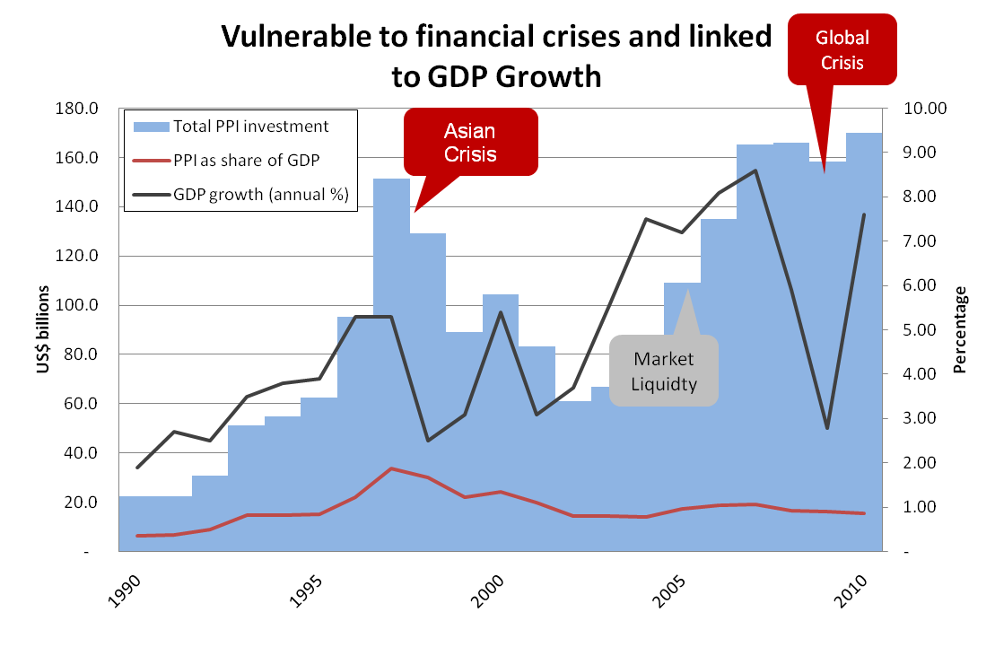
Private sector is important source of funding but is cyclical

Slide 7
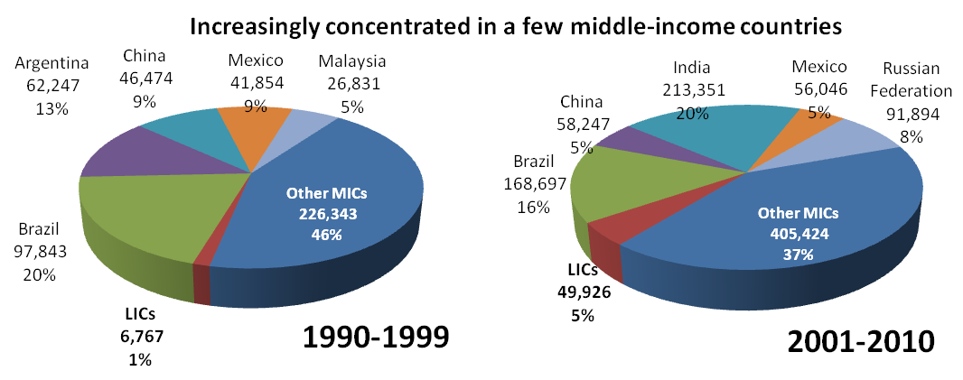
. . . and uneven across countries
Source: World Bank and PPIAF, PPI Project Database. (http://ppi.worldbank.org)
PPPs mobilized $170 Bn of investment (in 2010) compared to about $95 Bn in resources from MDBs and ODA (in 2009)
Notes:
Shares of other MICs have declined
LIC’s shares and volume of financing have increased, indicated potential for mobilizing private financing.

Slide 8
Why are guarantee instruments so relevant in the current environment?
Support infrastructure investment plans: Improves access to affordable financing for infrastructure investments (longer maturities, lowering spreads)
Facilitate access to increasingly tight markets: Euro crisis has weakened the banking industry and reduced the risk appetite of private financiers
Respond to the current banking industry environment and regulations: BASEL III regulations will increase funding costs, particularly for long-term non-recourse debt
Develop local markets: Opens access to long-term local liquidity that is locked due to an inexistent transaction track record or shallow markets

Slide 9
World Bank Guarantee Products and Operations to Date

Slide 10
Guarantee Products at the Bank
Partial Risk Guarantees (PRGs): support private sector projects by covering debt service default caused by government non-performance of its contractual obligations to a specific investment project
IBRD & IDA Countries
IBRD Enclave (for export oriented projects) in IDA Countries
Debt (Loans/Bonds/Notes) & Shareholder Loans
Policy-Based Guarantees (PBGs) and Partial Credit Guarantees (PCGs): support sovereign borrowing & public sector projects by covering a part of the debt service default/credit risk of public-sector borrowers
IBRD Countries only
PBGs support budgetary financing, while PCGs support investment projects
Debt (Loans/Bonds/Notes) & Shareholder Loans
Notes:
IEG report concludes that the pricing of Bank guarantees has not been a constraint on demand for the instruments

Slide 11
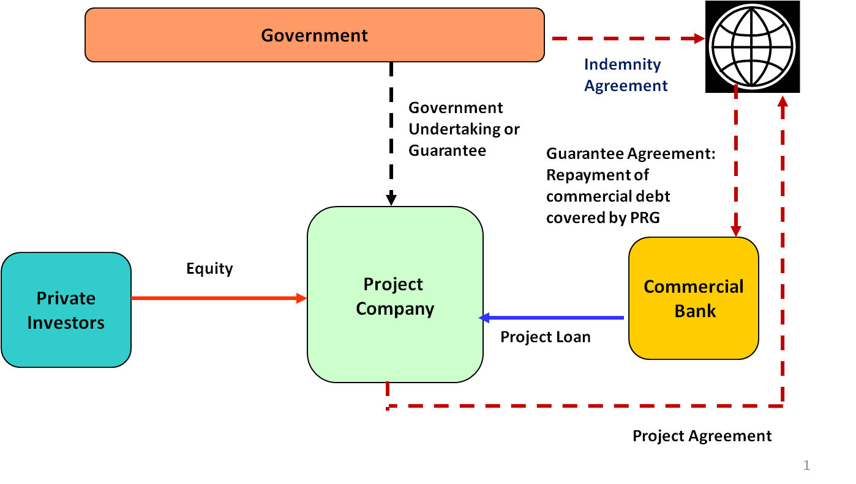
Partial Risk Guarantees
Typical PRG Structure
PRGs can cover a variety of risks associated with government contractual obligations, including the risk of non-payment by a government/SOE, regulatory risk, and expropriation risk.

Slide 12
Partial Risk Guarantees
Kribi Power in Cameroon (2011)
Opened new access to local long-term commercial financing, for US$82 million, thus developing the domestic financial sector.
Supports the country’s poverty reduction strategy which targets a substantial increase in supply of electricity.
PRG complemented by:
IFC A loan (US$86 million)
Bank investment lending in support of rural electrification and strengthened management of environmental and social impacts
Notes:
PRG also covers payment for modification, breach or termination of concession contract.

Slide 13
Partial Risk Guarantees
Electricity and Gas in Nigeria (2009)
Covers public power utility’s payment obligations under gas supply agreements, for US$400 million through a Letter of Credit (L/C) structure
Supports government’s power sector reform strategy
Additional financing for US$200 million currently being developed
Power Generation in Kenya (2012)
PRG series to cover public utility’s payment obligations to four IPPs using a L/C structure, for US$166 million
Supports the country’s Vision 2030, by addressing acute power shortages through private financing, given fiscal constraints
IFC is expected to provide loans and MIGA to offer PRIs for termination payment obligations under the Power Purchase Agreement
Notes:
Electricity and Gas in Nigeria
Complemented by IDA credit for $200 million for (a) investments in transmission and distribution; and (b) TA and capacity building.
Encourages private investments in gas infrastructure
Major government sector reforms, including (a) restructuring of power utility (unbundling of generation, transmission and distribution); (b) independent regulatory authority; and (c) pricing reforms
MIGA Investment Guarantee will further leverage IDA and IBRD resources by providing insurance to cover breach of contract, termination payments under the PPAs, expropriation, transfer, inconvertibility and war/civil disturbance risks, depending on the risk mitigation requirements of relevant investors and lenders.
Power Generation in Kenya
Kenya has carried out major energy sector reforms (unbundled key players, opened the door to competition, independent regulatory commission) and has perhaps the best performing energy institutions in SSA.
Although governance of sector is relatively good, risk perceptions of international investors have deteriorated since political violence in December 2007 and global financial crisis.
IPPs selected through a competitive procurement process.

Slide 14
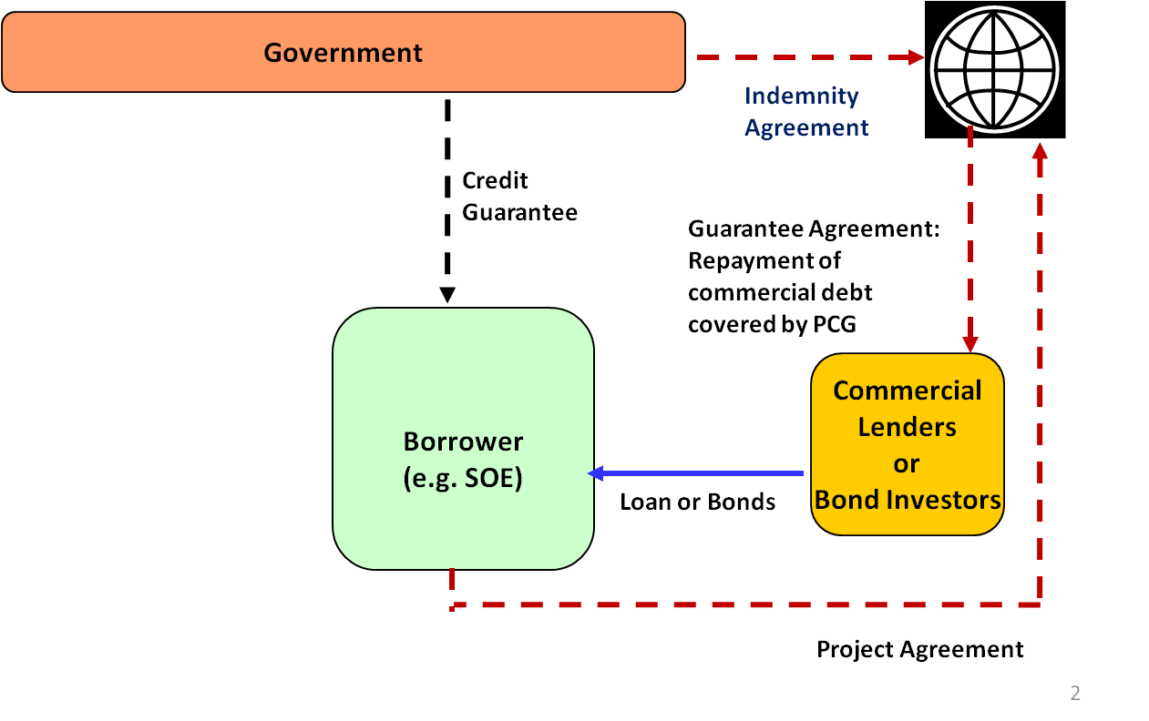
Partial Credit & Policy-Based Guarantees
Typical PCG Structure
PCGs can be offered to Governments, their political subdivisions and state-owned enterprises
PBGs support sovereign borrowing associated with policy and institutional reforms

Slide 15
Partial Credit & Policy-Based Guarantees
Morupule B PCG in Botswana (2010)
Helped the country address a potential energy crisis
Extended maturities of US$825 million loan from 15 to 20 years by covering debt service payments of US$243 million for those years
Resulting lower revenue requirements benefited electricity consumers and economy in general through lower tariffs
Serbia Private and Financial Sector PBG (2010)
Improved access to markets constrained by global financial crisis, by covering bullet maturity of €400 million loan
Supported reforms to improve business climate and strengthen financial system through restructuring of banking sector
Notes:
Botswana Morupule PCG complemented by loans from IBRD and AfDB, helping to mobilize substantial amounts of financing despite the global financial crisis.

Slide 16
Complementarity of Bank Group Guarantees
 | World Bank | MIGA | IFC
Risk Coverage | Govt./Parastatal Obligations (PRG) & Govt./Parastatal Credit Risk (PBG/PCG) | Political Risk | Credit Risk
Type of Eligible Investment Instruments for cover | Debt (International or Domestic) & Letters of Credit | Equity & Debt (Foreign only) | Debt (International or Domestic)
Product Characteristics | Designed to meet market requirements | Choice of specific coverage | Designed to meet credit risk enhancement needs
Pricing | Uniformly priced, risk managed through size of lending programs | Market-based | Market-based
Sovereign Guarantee | Yes | No, but requires host country approval | No
Eligibility Criteria | Priority projects for the Government | Any Foreign Direct Investment | Private enterprises and creditworthy sub-nationals
Major Clients | Host Government | Private Sector | Private Sector
Origination | Mainly with client countries, and in support of CAS objectives | Mainly with private sector investors & lenders, on demand | Mainly with private sector investors & lenders, on demand
16

Slide 17
Operational Track Record
41 guarantees in 31 countries for a total of $4.7 billion
Significant leverage: $27.5 billion in project financing mobilized by guarantees for $3.2 billion
Mostly PRGs, many in power sector: 29 PRG, 8 PCG and 4 PBG
Mixture of IBRD and IDA: 24 IBRD guarantees and 17 IDA PRGs
Allocation by Sector (in US$ million)
Allocation by Region (in US$ million)
Note: Charts reflect operations approved through December 2011
Notes:
Power sector largest, followed by fiscal support (PBGs)
Africa and ECA largest beneficiaries, but all regions benefited

Slide 18
The Need for Modernization

Slide 19
Guarantee Modernization in Context
Modernization of the operational policy is part of a broader Bank agenda for promoting private sector and infrastructure development:
Modernization of Guarantee Policy
Providing enhanced support for the preparation of PPP projects
Improving the deployment of specialized staff skills
Strengthening the outreach to clients and marketing of guarantees
Enhancing WBG collaboration and coordination, among Bank guarantees, MIGA political risk insurance and IFC guarantees and lending

Slide 20
Why do Guarantee products need modernization?
Bank guarantees could further respond to client needs for development financing
Increased opportunities and unmet demand:
Expansion of emerging markets since the Bank’s guarantee instruments were introduced in 1990s
Unmet demand for development financing lower down the income spectrum
Constrained supply of development financing:
Impact of the global financial and European sovereign debt crises
Commercial lenders under pressure to increase capital and strengthen balance sheet
Need to leverage limited Bank capital and constrained ODA

Slide 21
Purpose of Policy Modernization
Support increased access to private development financing for member countries by:
Streamlining, consolidating and enhancing the applicability of the guarantee instrument
Removing any unnecessary and outdated policy provisions
Ensuring borrowing is done in a prudent and sustainable manner
Reflect G20 discussions on the need for greater use of WBG guarantees.
Notes:
Proposed changes are outlined in the Approach Paper: “Modernizing the World Bank’s Operational Policy on Guarantees”

Slide 22
Modernization Proposals and Issues for Consultation

Slide 23
Key Modernization Proposals
Two overarching themes to the proposed changes:
Extending PCGs and PBGs to IDA countries
Aligning policy requirements for guarantees with their corresponding lending instruments, thereby streamlining and consolidating requirements and making the instrument more timely and useable
The proposed policy changes also seek to retain flexibility in structuring guarantee operations to fit specific client needs and project circumstances

Slide 24
Extending Partial Credit Guarantees to IDA countries
PCGs would be available for IDA countries which have low risks of debt distress and adequate debt management capacity, but…
For countries which do not meet the country level criteria, there would be exemptions for projects with significant financial returns
The proposed approach would help IDA countries address significant financing gaps and also ensure prudent and sustainable borrowing
Both country and project considerations are reflected in the eligibility criteria
Notes:
In line with the Bank’s Non-Concessional Borrowing Policy

Slide 25
Extending Policy Based Guarantees to IDA countries
PBGs would be available for IDA countries which have low risks of debt distress and adequate debt management capacity
No exemptions are considered, as PBGs support borrowing for general budget financing and hence are not associated with a specific investment project
The proposed approach would help IDA countries address significant financing gaps and also ensure prudent and sustainable borrowing

Slide 26
Aligning policy requirements for guarantees with lending instruments
PRGs and PCGs & Investment Loans (ILs)
Bank Safeguards: Supervise only up to the completion of the project that is benefiting from the guarantee (as in Investment lending)
However, supervision would continue after project completion for any applicable legal covenants, if required by a specific safeguard policy, or to address Management concerns about compliance
Sector policy framework. Standardize requirements across guarantee options regarding the requirement on sector policy framework
Additional financing and project restructuring. Introduce additional financing operations and project restructuring to guarantees (currently available only for ILs)

Slide 27
Aligning policy requirements for guarantees with lending instruments
PBGs & Development Policy Loans (DPLs)
Allow the use of PBGs to support local in addition to international financing
The country’s reform program supported by the PBG would be assessed against the country’s track record, as required for DPLs
For countries that already have some market access, PBGs can be used to improve financial terms and achieve financial leverage
PBGs will continue to be subject to the operational policies for DPLs

Slide 28
Further Innovations
Innovation has been a key feature of Bank guarantee operations
The operational policy on guarantees provides flexibility in structuring guarantee operations to fit specific client needs and project circumstances
Specific structures have been developed to backstop government payment obligations
Guarantee series and guarantee facilities provide a mechanism and framework for multiple guarantees
As part of the policy paper, Management intends to explore the possibility of extending guarantees to:
Carbon contracts to support low-carbon projects for reducing greenhouse gas emissions
Hedging products

Slide 29
Consultations: Guiding Questions
How can the guarantee instrument be designed to best help developing countries meet their development financing needs?
Do you think that the proposed policy changes will enable better, more effective and broader use of the Bank guarantee instrument? If not, how can we improve it?
Do you agree with the proposal to introduce partial credit guarantees (PCGs and PBGs) to IDA countries, based on new eligibility criteria? Do you think these criteria can help ensure that the resulting debt is prudently managed and sustainable?
Do you think that the policy requirements for project-based guarantees should be aligned with those for investment lending, including the supervision responsibilities for Bank safeguard policies?
Do you think that the policy requirements of policy-based guarantees should be aligned with those for DPLs?
Do you think that the Bank should explore the possibility of extending guarantees to support low-carbon projects to combat climate change and also to hedging products?
Do you have other suggestions or comments?

