Slide 1
World Bank Group COUNTRY PARTNERSHIP FRAMEWORK with IRAQ
FY18 – FY23

Slide 2
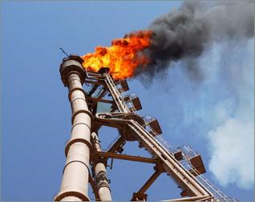
LOWER OIL PRICES PRESENT AN OPPORTUNITY for change
Low oil prices present an opportunity to advance on difficult reforms and diversify the economy. The energy sector is a priority sector to reform and responds directly to social discontent. Gas capture and reuse is a low hanging fruit.
The private sector, including SMEs and local investors, can play a key role in creating jobs. Foreign investments need to be attracted to come to Iraq.
Iraq is well placed to re-establish itself as a regional hub for trade and connectivity. Iraq also has high potential for inter-connectivity among governorates and regions. Inter-governorate and sub-national relationships can be strengthened.

Slide 3
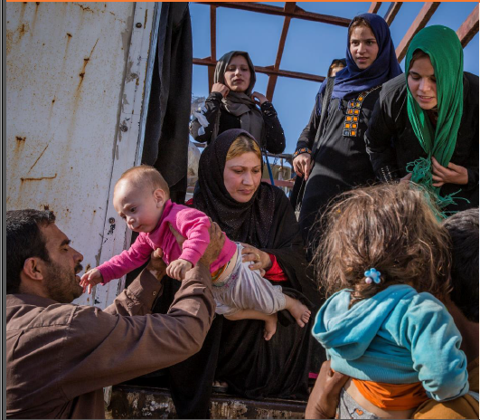
Reconstruction must be inclusive & sustainable
Liberating the governorates of Anbar, Saladdin, Diyala and Mosul, is both a military and political victory and presents a unique opportunity for national reconciliation, and re-instatement of trust between the State and its citizens.
Recovery and Reconstruction needs are enormous and will require international support, as well as private sector involvement.
The process must be nationally-led, efficiently implemented and demonstrate adherence to best practice principles.
Over 5 million IDPs will return home. They will need immediate access to security, shelter and basic services. Many will be poor and/or female-headed households and will need sustainable social safety nets and access to cash and work.
Photo courtesy of United Nations

Slide 4
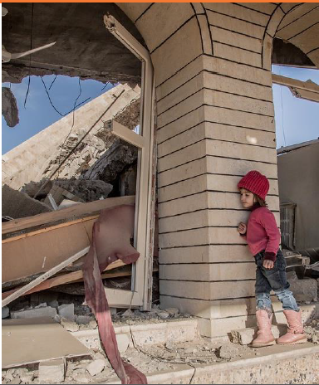
Women, Youth and the poor are high priority
Development of the education system in Iraq is essential to build up the young generation, who will be the leaders of the construction of Iraq’s future.
The poor in rural and lagging regions will benefit greatly from modern agriculture value chains. This requires close attention to water resources management and the environment.
Iraqi women and girls are a significant asset to the economy and society and are well-placed to play an even larger role in Iraq’s development.
Photo courtesy of United Nations

Slide 5
PROPOSED WORLD BANK GROUP Strategy - FY18 – FY23
Focus Area 1:
Institutional Strengthening and Efficiency through Improved Governance and Fiscal Stabilization
Strengthen government wage expenditure controls
Support improved efficiency of the energy sector
Strengthen institutional framework for private sector development
Improve National Payments System and help implement anti-money laundering laws
Improve public financial and investment management
Focus Area 2:
Delivery of Services to the People through Social Protection, Reconstruction, and Economic Recovery
Improve social protection systems
Support infrastructure reconstruction and public service delivery in conflict-affected areas
Support economic development of poor and lagging regions
Improve quality and efficiency of infrastructure service delivery at the subnational level

Slide 6
PROPOSED WORLD BANK GROUP Strategy
Focus Area 1:
Institutional Strengthening and Efficiency through Improved Governance and Fiscal Stabilization
Strengthen government wage expenditure controls
Support improved efficiency of the energy sector
Strengthen institutional framework for private sector development
Improve National Payments System and help implement anti-money laundering laws
Improve public financial and investment management
Examples of support anticipated:
Follow on DPF’s
Policy support and de-risking instruments for private sector development
Public Financial Management Investment
Technical Assistance on Doing Business Reforms
Technical assistance in Gas to Power Investment Plans
Technical assistance for reform and development of SME’s

Slide 7
PROPOSED WORLD BANK GROUP Strategy
Improve social protection systems
Support infrastructure reconstruction and public service delivery in conflict-affected areas
Support economic development of poor and lagging regions
Improve quality and efficiency of infrastructure service delivery at the subnational level
Focus Area 2:
Delivery of Services to the People through Social Protection, Reconstruction, and Economic Recovery
Examples of support anticipated:
Social Fund Project
Emergency Operation for Development Additional Financing
Support for mobilization of reconstruction MDTF
Baghdad Water and Sewerage Investment
Agriculture in Lagging Regions Investment
Customized Poverty Targeting Tools
Technical Assistance on inclusion of conflict affected youth

Slide 8
Thank you

