Slide 1
Kosovo Country Partnership Framework FY17 – 21 – Systematic Country Diagnostic
Public Consultations

Slide 2
COUNTRY CONTEXT AND DEVELOPMENT CHALLENGES

Slide 3
Kosovo: Fragile post-conflict economy aspiring to EU
Kosovo declared independence in February 2008, after being UN protectorate since 1999. Since then Kosovo made progress both on the economic front and the EU accession process. It remains however challenged by a number of fragility factors.
Incomplete diplomatic recognition remains a key obstacle. Kosovo is recognized as independent by 109 out of 193 UN member countries, and 23 out of 28 EU member states.
Other causes of fragility: weak rule of law; lack of interethnic cohesion; traditionally close network of personal ties and loyalties dominate business relations; high youth unemployment and risks of radicalization; poor governance and accountability; challenges with including minorities and integrating returnees and IDPs; and lagging regions.
Kosovo is potential candidate for EU membership. In recent years, the country has accelerated its EU integration process, including through: (i) signing the Stabilization and Association Agreement (SAA) with the EU in October 2015 which came into effect on April 1, 2016; and (ii) deepening coordination with the EC on economic policies and governance issues.

Slide 4
Growth in Kosovo has been positive and above Western Balkans average
Real GDP Growth, 2008-2016
Source: World Bank staff calculations based on data from national statistical offices.

Slide 5
Growth is driven mainly by consumption
fueled by remittances and ODA
Kosovo decomposition of real GDP growth, 2011-2016
Kosovo remittances and ODA, percent GDP, 2009-2012
(Est.)

Slide 6
Limited role of exports that remain unsophisticated
and poorly diversified
Export, percent of GDP 2009-13
Export Composition by Product Groups
2005 (inner circle) vs 2014 (outer circle)
Export Composition by Country
2005 (inner circle) vs 2014 (outer circle)

Slide 7
FDI Performance is weak and new FDI jobs were in
non-tradable sectors
Source: WB WDI
Source: FDI Markets

Slide 8
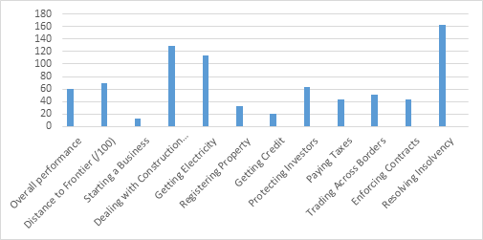
Infrastructure Bottlenecks are among the Top Constraints for Private Sector Growth….
…. Investment Climate Reform Agenda Is Yet To Be Completed….
Doing Business Rank, 2017

Slide 9
…. and Financial Intermediation Remains Low and Access to Finance Problematic
Source: WB WDI
Source: BEEPS 2013
Source: BEEPS 2013
Source: BEEPS 2013

Slide 10
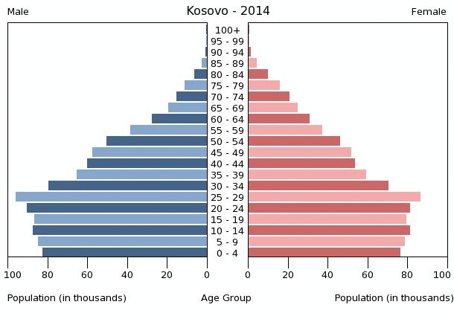
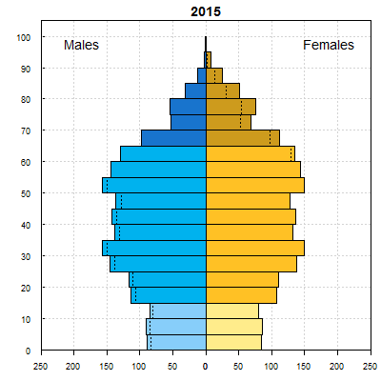
Kosovo has the potential to achieve exceptional growth performance if it utilizes its demographic dividend…
Population Pyramid: Kosovo vs BiH comparison
Bosnia and Herzegovina

Slide 11
…but it continues to face high structural unemployment, low labor force participation rates, and ...
Kosovo unemployment rate, percent of LF, 2015
Activity rates as percent of population over 15 years of age, 2015
Largest gender gap in Western Balkans
Sources: World Bank staff calculations based on national statistical offices.
Note: The regional total excludes Kosovo.
Sources: National statistical offices and Eurostat 2015 data.
Note: Kosovo data is for population aged 15-64.

Slide 12
... a large reliance on non-wage income in households …
Kosovo: Income shares by source and consumption decile
Source: HBS, Kosovo Agency of Statistics

Slide 13
…leading to declining productivity
Wages and Productivity in Kosovo
Source: Ministry of Finance data.
Note 100= 2003Q4

Slide 14
Despite progress in poverty reduction, Kosovo remains one of the poorest country in Europe
Real GDP per capita, percentage of EU average income per capita
Poverty headcount in Kosovo, 2000-2013
Source: World Bank staff analysis of Kosovo Household Budget Surveys
Sources: World Bank staff calculations based on national statistical offices.
Note: The regional total excludes Kosovo.

Slide 15
Kosovo in a self-perpetuating cycle…

Slide 16
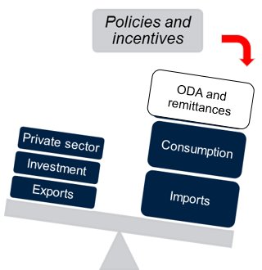
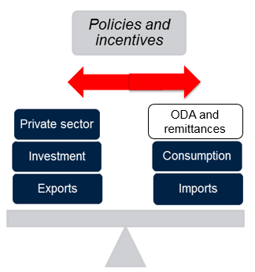
Need to rebalance growth towards higher productivity and greater competitiveness
Reforms to support rebalancing of growth towards higher productivity and greater competitiveness:
While preserving fiscal discipline, reprioritize public expenditures and reorient taxation
Improve energy security via affordable and comprehensive energy strategy
Enhance the infrastructure networks and environment for business expansion in tradable sectors to reap the benefits of European integration.
Strengthen inclusion by building human capital and providing equal opportunities to tap into unemployed/underemployed resources.
Improve stewardship of Kosovo’s environment and natural resources.
Declining marginal benefits: shrinking ODA by reduced security concerns; slowing pace of public investment by past reconstruction efforts; dynamism of the non-tradable sector aconstrained by the small internal market.
Mounting social pressure: protracted low job creation, demographic pressures, and emigration.
EU accession: structural transformation and heightened productivity to cope with competitive market forces and provide opportunities for income catch up.

Slide 17
Key Priorities
Maintaining macroeconomic stability while reprioritizing public expenditure
Reducing infrastructure bottlenecks and creating a more attractive business environment for private investment and expansion of tradable sectors
Better stewardship and greater productivity of natural resources
Greater inclusion by building human capital and providing equal opportunities
Rebalancing growth towards higher productivity and greater competitiveness
Refocusing Kosovo’s growth agenda requires retaining several features of its economy as a foundation, while increasingly tapping into production factors—natural and human resources—that are either chronically underused or not used at all. This will help expand opportunities for the poor to sustainably improve their welfare, reduce poverty, and promote shared prosperity. To broaden the economy’s narrow production base, boost job creation, and reduce the heavy dependence on imports, Kosovo’s current growth strategy needs to be amended across the board through new governance, macroeconomic, structural, and social policies.

Slide 18
Detailed Priorities (see Annex for details)
Maintaining macroeconomic stability
Reducing infrastructure bottlenecks and create a more attractive business environment
Better stewardship and greater productivity of natural resources
Building human capital and providing equal opportunities
Improve the allocation and efficiency of public expenditure
Improve governance, rule of law and business climate
Increase productivity in agriculture
Increase employment and labor productivity through education
Strengthening tax policy and administration
Ensure sustainable management of natural resources
Increase quality and equality of opportunity through labor policies
Reduce energy bottlenecks
Deepen and widen financial intermediation
Increase quality and equality of opportunity through social protection
Reduce transport bottlenecks
Increase the quality and equality of opportunity through health
Reduce ICT bottlenecks

Slide 19
Annex: Detailed Priorities

Slide 20
Detailed Priorities
Maintaining macroeconomic stability while reprioritizing public expenditure
Align the budget more closely with development needs and improve the allocation and efficiency of public spending: In a euroized economy, the capacity for maintaining healthy public finances by successfully implementing fiscal rules, avoiding spending pressures from nonpriority areas, and generating alternative revenues is vital to creating sufficient resources necessary for public investments to improve competitiveness and crowd in the private sector, while protecting the poor and vulnerable from unforeseen shocks. In this context, the key to breaking bottlenecks and generating productivity gains is knowing which public investments in which areas are needed to establish the proper balance between stabilization and development objectives.
Strengthening tax policy and administration: Meeting all fiscal needs will be more difficult in the future if, as expected, border revenues decline as EU integration and free trade agreements advance. A gradual shift to domestic revenue and direct taxation is necessary and feasible. Tax policy also needs to reflect the degree of compliance, the size of the shadow economy (which is estimated at 27–35 percent of gross domestic product), and the capacity of the tax administration to adopt appropriate international best practice.
Deepening and widening financial intermediation are key to channeling savings, including remittances, through the formal financial system and toward productive investments and job creation. This is particularly important because more than 98 percent of businesses are family-owned microenterprises and SMEs.

Slide 21
Detailed Priorities
Reducing infrastructure bottlenecks and
create a more attractive business environment
Improve governance and rule of law: Good governance is an element of the soft infrastructure that is necessary for a well-functioning, competitive, and innovative market economy that has discarded the socialist legacy. The inadequate development and performance of governance institutions, particularly the shortcomings of the judicial system, are a major obstacle to business success. Because they raise the costs and risks associated with doing business, they encourage the offering, giving, receiving, and soliciting of bribes. Addressing gaps in soft infrastructure would also help strengthen social cohesion.
Enhance the business environment: The establishment of an effective legal, regulatory, and administrative framework to govern trade and investment would help enhance the capacity of businesses to withstand competitive pressures and connect with global value chains, thereby generating jobs and spurring competition, innovation, and productivity increases. A number of policies that support trade and investment need more work, including in strengthening property rights; reforming and streamlining licensing; reforming inspections; implementing customs and trade regulations; streamlining standardization, accreditation, and certification systems; enhancing foreign direct investment and export promotion; clarifying competencies on competition; and tightening the arrangements for corporate governance, financial reporting, and auditing. Secure property rights: develop the land market, and coordinate the use of national geographical data. Moreover, Kosovo already has comparative advantages in several goods (garments, textiles, and food) and services (travel and communications). Manufacturing has the potential not only to spur income and exports, but also to generate employment among skilled and unskilled workers. Given their direct impact on other sectors and on human capital formation, modern services, which are already a major source of income, have the potential to transform Kosovo’s economy. However, manufacturing and modern services have been held back by large regulatory and infrastructure gaps.
Ensure reliable and affordable energy: Energy insecurity has heavy costs for businesses and is the largest obstacle to attracting high-quality FDI to Kosovo. Relying on external suppliers is not realistic from either a supply security or a cost perspective. Short term energy deficits can be partly addressed by increased regional interconnectivity. In the long run, though, after taking into account the costs of environmental and social externalities, the lowest cost energy alternative is likely to incorporate a mix of renewable energy, energy efficiency measures and a new fossil-fuel plant that would substitute the obsolete coal-fired Kosovo A. An ongoing update of World Bank study evaluating supply options for Kosovo will assess such energy alternatives.
Reduce transport and ICT bottlenecks: In a small and landlocked economy, connectivity is critical to successful integration with regional and global markets. Kosovo has invested heavily in new physical capital, but the investment in new highways risk squeezing out other public investments. Also strategic for Kosovo’s competitiveness is addressing infrastructure bottlenecks in broadband digital communications, which can pave the way for income growth and job creation.

Slide 22
Detailed Priorities
Better stewardship and greater productivity
of natural resources
Increase productivity in agriculture. Agriculture accounts for about 12 percent of GDP and 25–35 percent of total employment. In Kosovo, it is also a safety net. About 60 percent of the population own land for cultivation, and 30 percent own livestock. About 60 percent of the poor live in rural areas and, to a large degree, depend directly or indirectly on agriculture for their livelihoods. However, there are structural and interrelated challenges to agriculture’s competitive and growth potential, including insufficient scale, financing, integration, and market links. Alignment with EU and international standards and technical regulations needs to be ensured. The sector will need to adapt to the drought and flood threats of climate change, which will affect Kosovo’s limited water resources.
Manage natural resources sustainably. Better stewardship of the environment and natural resources is a key to immediate social welfare improvements and the long-term sustainability of inclusive growth. Given the abundance of natural resources and fertile land, greater productivity and sustainability in agriculture and mining, in which Kosovo displays strong comparative advantages, are crucial to better export performance and import substitution and to generating the resources for development. Modernizing these sectors, strengthening institutions and policies, and implementing smart technical standards, good practices, and regulations are necessary for exploring the potential of these sectors, while alleviating the risks associated with the environment, resettlement, and health and achieving compatibility with EU norms. This will also require actions to mitigate and adapt to climate change. Addressing governance issues and establishing a framework to distribute equitably the rents generated from natural resources are also essential for shared prosperity.

Slide 23
Detailed Priorities
Greater inclusion by building human capital and providing equal opportunities
Increase employment and labor productivity through education: More jobs and more productive workers are vital to building the critical human capital that is necessary to ensure that low-income households participate in and benefit from economic growth. Kosovo has a young population and a potentially large demographic dividend, which makes the jobs agenda all the more critical. Improving the quality and relevance of education at all levels and ensuring equitable access to educational opportunities at early ages is a first step that needs to be complemented by more opportunities to acquire the skills that private employers are seeking. The development of these skills opens up wage employment opportunities, but it may also stimulate greater self-employment and entrepreneurship in such areas as agribusiness, information and communication technology (ICT)–enabled jobs, and other emerging sectors. Given Kosovo’s extremely low labor force participation, improved opportunities are needed for women and minorities.
Increase quality and equality of opportunity through labor policies, social protection and health: For greater social inclusion and cohesion, policies are needed to enhance the opportunities of all wealth groups, ethnicities, and regions to access health care, education, and social protection equitably. A large share of the population is vulnerable to income shocks and falling back into poverty, and the social safety net has major gaps. Building up institutions, improving targeting, and making public spending more efficient in health care, education, employment services, and last-resort social assistance would promote equal opportunity and short-term protection. Given Kosovo’s history, better targeting and coverage in social protection is paramount, and budgetary support should be directed to the poor rather than special interest groups. Shortcomings in the inclusion and participation of women at all levels of society are a major concern. Health outcomes could be enhanced by shifting the focus from hospitals to primary care, water, and sanitation to meet basic needs.

Slide 24
Questions
Would you agree that the priorities identified by the SCD are the right ones for Kosovo?
What are in your views the top three challenges/obstacles to Kosovo’s development, that need to be overcome to create more jobs and increase prosperity?
The World Bank Group's goals are to end extreme poverty and promote shared prosperity. To contribute to these goals in Kosovo, in which three priority areas should the WBG focus its attention and resources – including with knowledge/studies - in the next five years? Where do you see the comparative advantage of an institution such as the WBG?

Slide 25
THANK YOU!

